Slide 1
Introduction to Robotics and Mechatronics
GROUP 2.5
Benson Chalethu
Pietro Griffa
Ingvar Groza
PostLab 07
Q1
B

Slide 2
Q2 & Q3

Slide 3
Q2 & Q3

Slide 4
Q2 & Q3

Slide 5
Q2 & Q3

Slide 6
Q4
The conversion factor we found is 15.3 pixel/mm

Slide 7
Q5

Slide 8
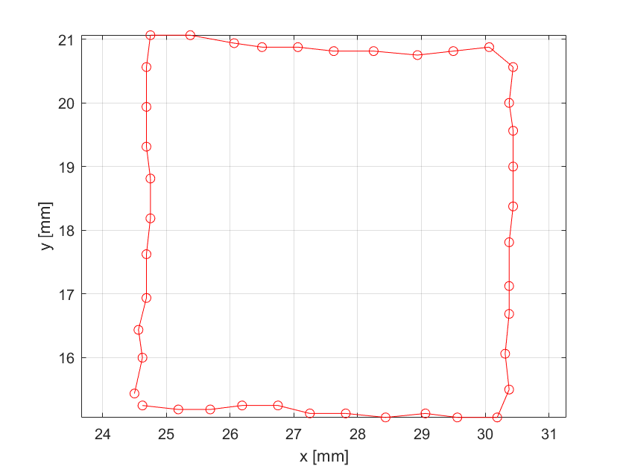
Q6
The image below shows the trajectory of the moved magnet. With the labeled axis the coordinates of the magnet can be determined.

